Slide 1

Practical application of artificial intelligence
Immerse summer school, 2022
By Akim Komarnitskii

Slide 2
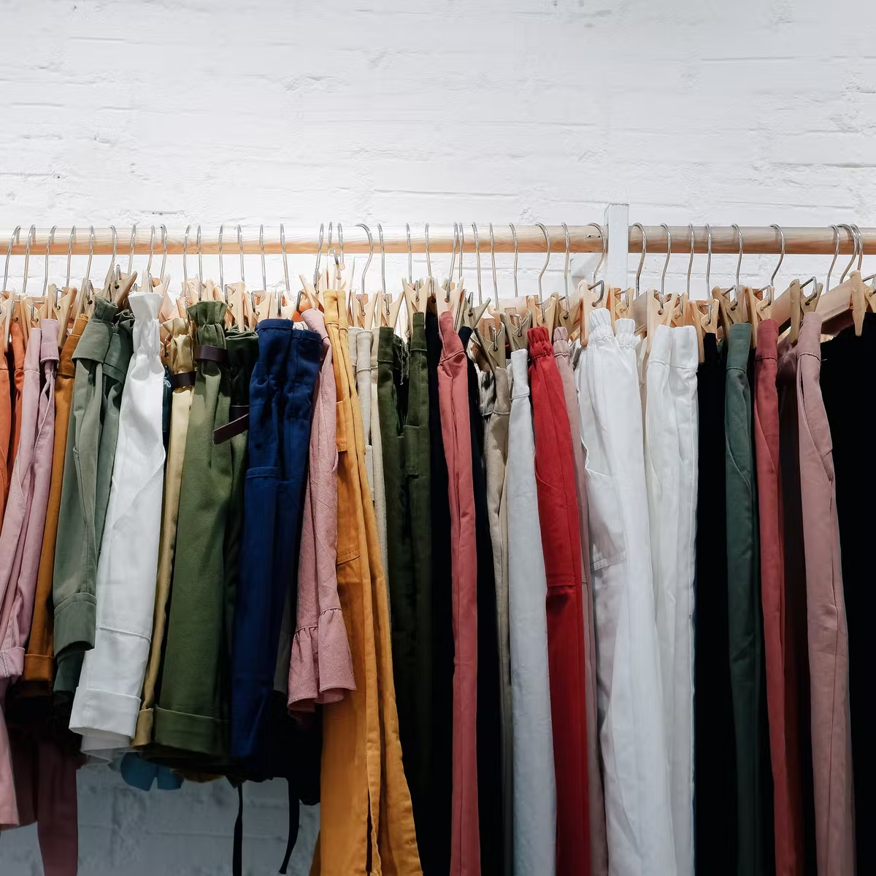
Motivation
Current system of shopping either online or offline is inefficient
Overwhelming number of unorganized options
Automatization can be applied to many processes to reduce the amount of manual labour

Slide 3
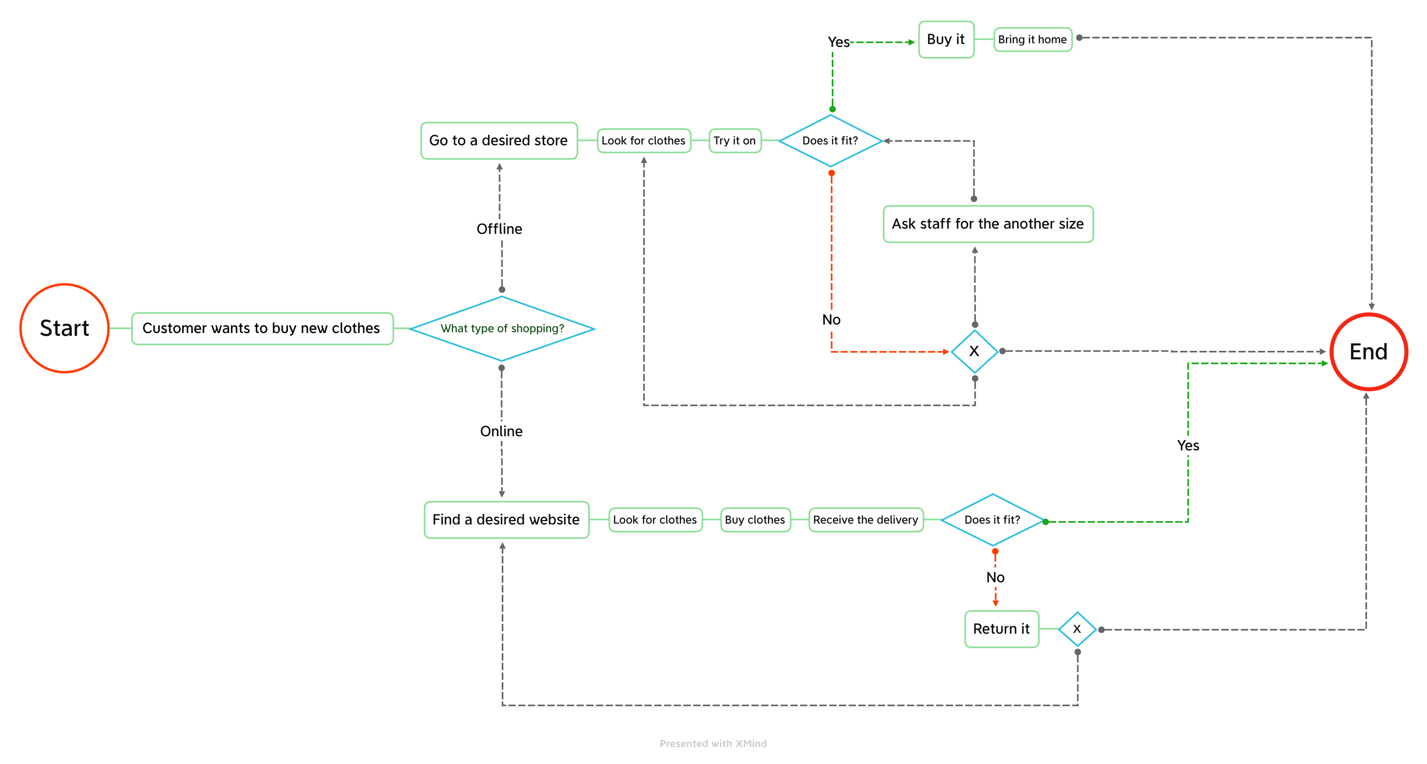

Slide 4
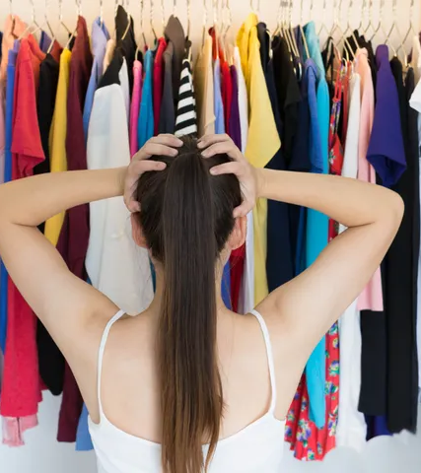
The problems
Shopping is a time consuming process, because you not only need to choose from countless number of options with little to no technical assistance, but also it could be hard to tell how a piece of clothing will look on you without trying it on first.
Not to mention that different companies have different standards of sizes (e.g. two pairs of shoes with size 42 from different companies will vary in actual size)

Slide 5
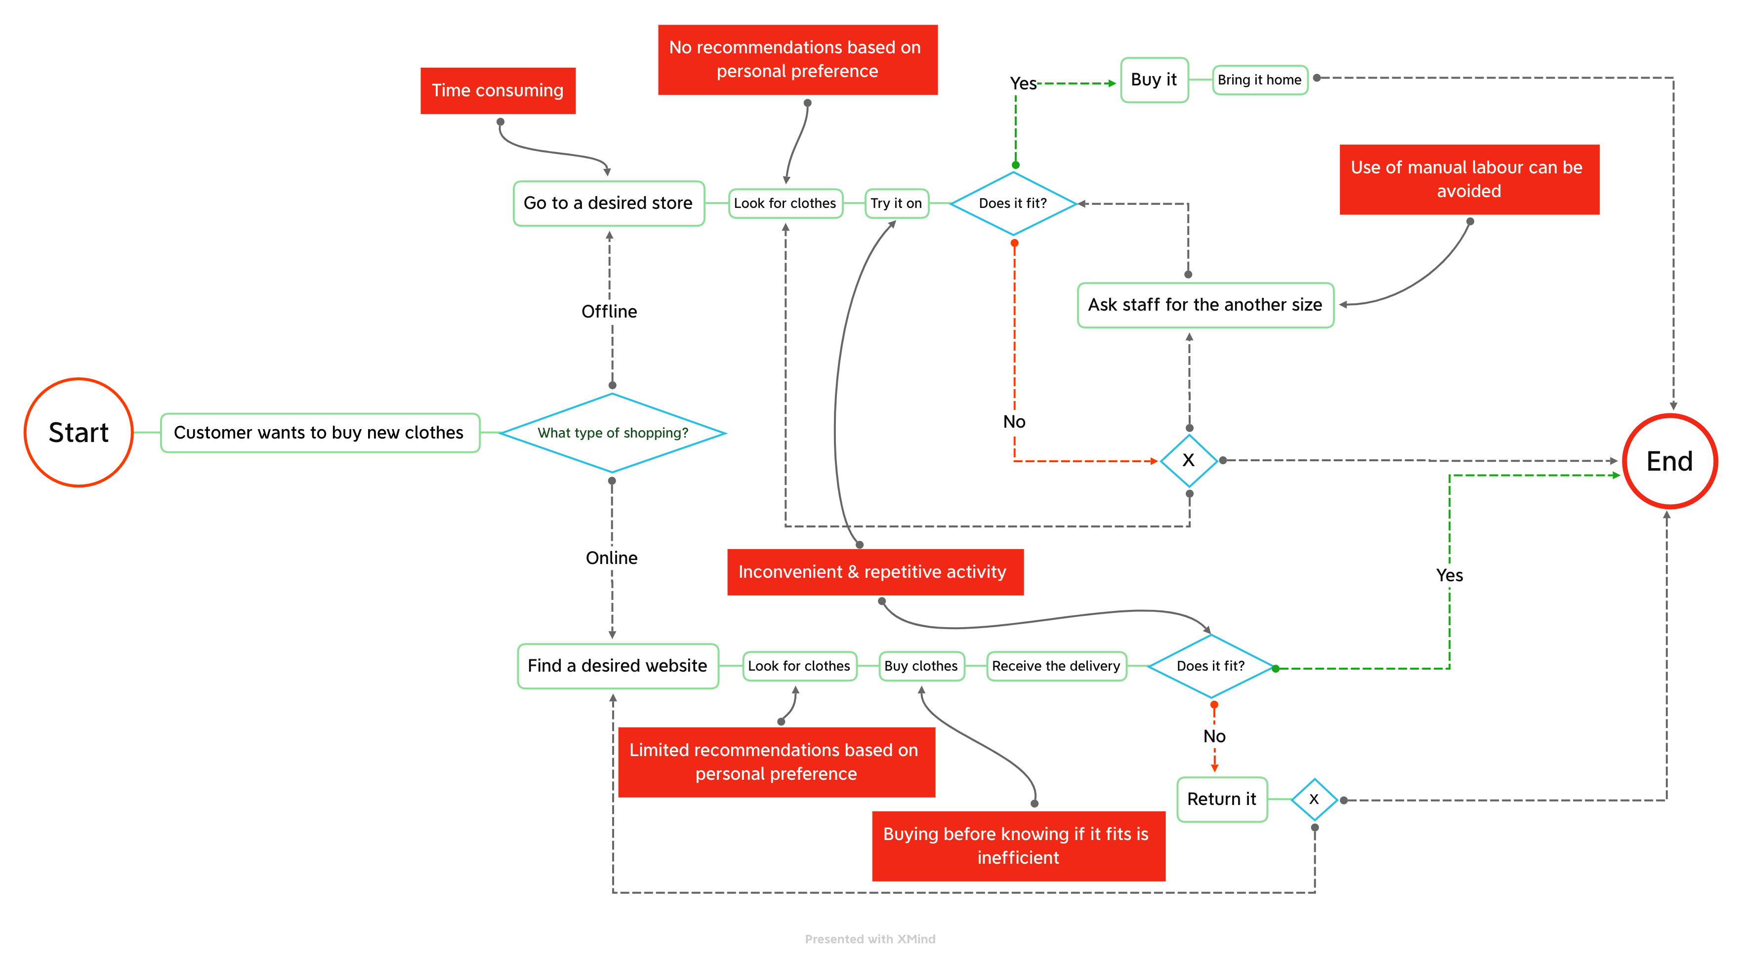

Slide 6
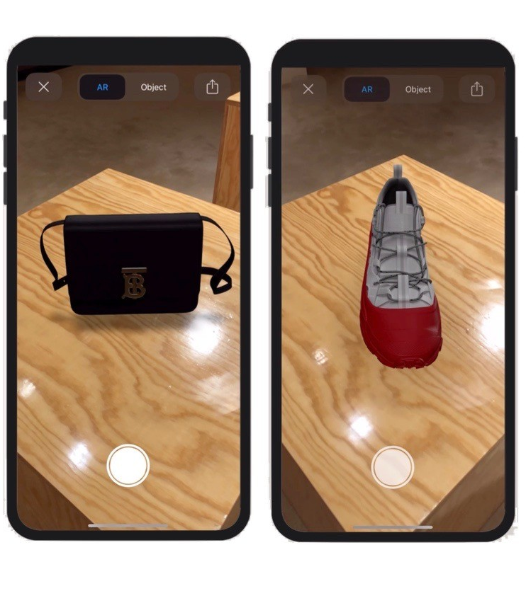
Solution
The use of AI and AR (Augmented Reality) can fully resolve the aforementioned problems in a more efficient and convenient manner compared to the current alternatives.

Slide 7
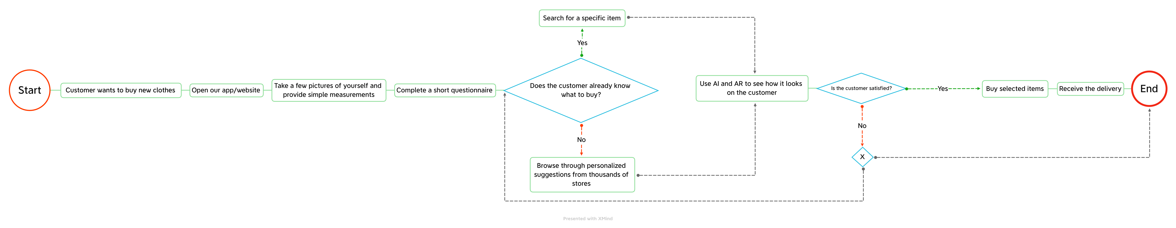
BPMN diagram

Slide 8
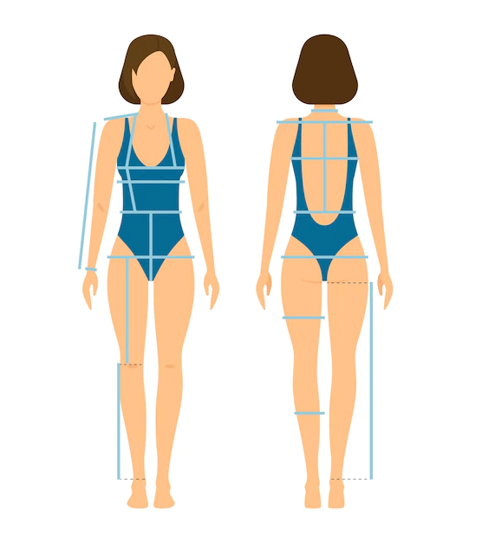
Dataset
Pictures of a person from different sides in underwear
Same person dressed with
Labels corresponding to clothing pieces
Essential measurements of body parts

Slide 9

Acquiring data
Publicly available sources (models, clothing shops, etc.)
Medical institution
Online submitions by volunteers

